Slide 1
Oracle Cloud Infrastructure Security
The Practice Workshop
Martin Berger
Stefan Oehrli

Slide 2
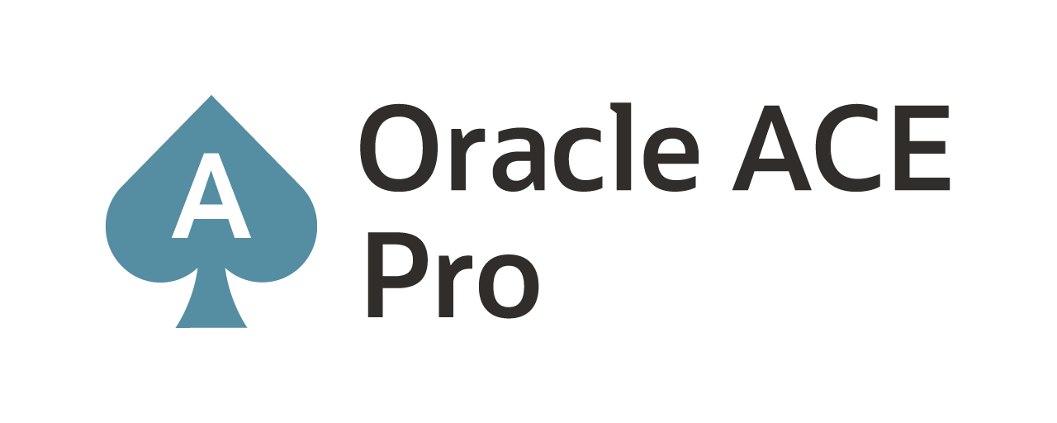
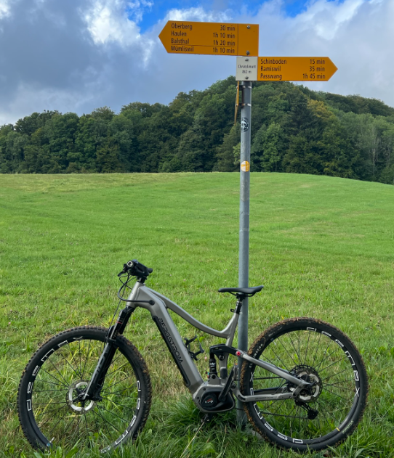
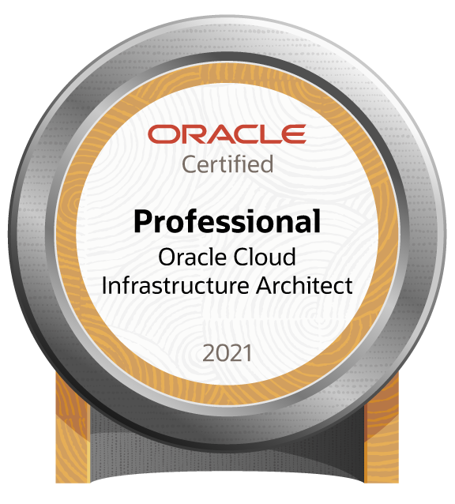
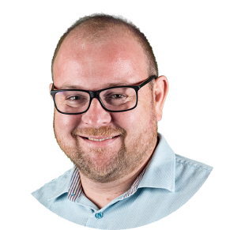
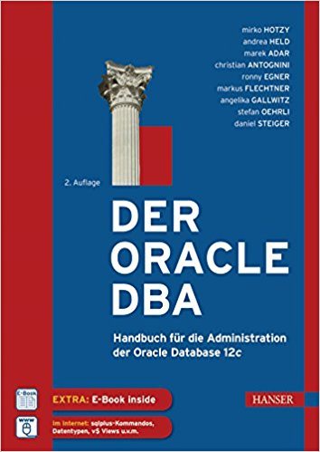


Martin Berger – Modern Data Platforms
Modern
Data
Platforms
stefan.oehrli@accenture.com
Tech Architecture Manager
Since 1998 working in IT
More than 22 years of experience in Oracle databases
Kestenholz / Jurasüdfuss / Switzerland
2 Junior-DBAs @ Home (8yrs & 10yrs)
Firefighter & E-Biker
Loves his companies' cultural values:
curiosity, doers, network, space, and together
Focus: Let’s go into the Cloud!
Co-author of the book The Oracle DBA (Hanser, 2016/07)
martinberger.com
@martinberger_ch

Slide 3

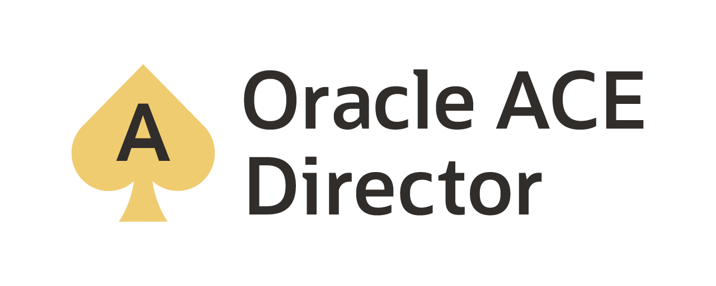
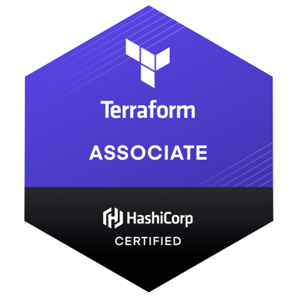
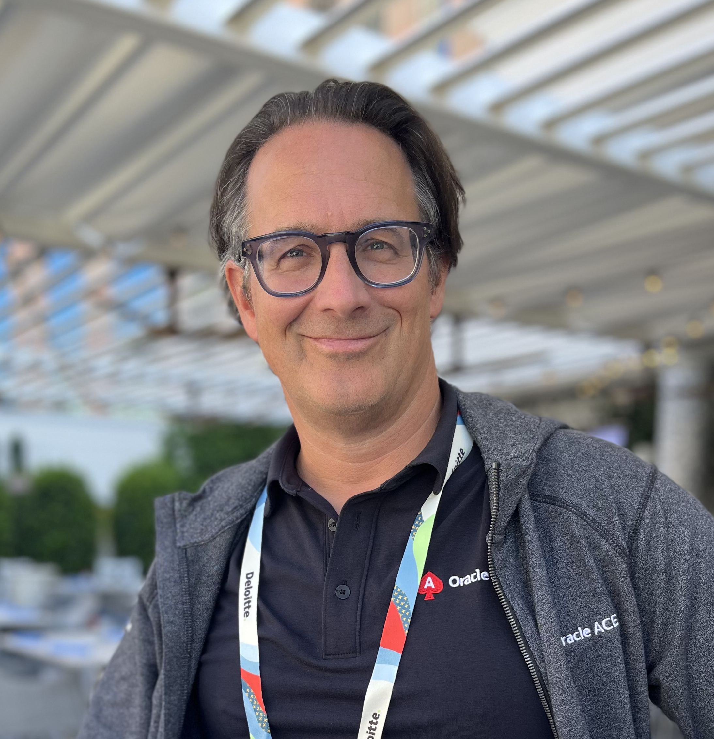
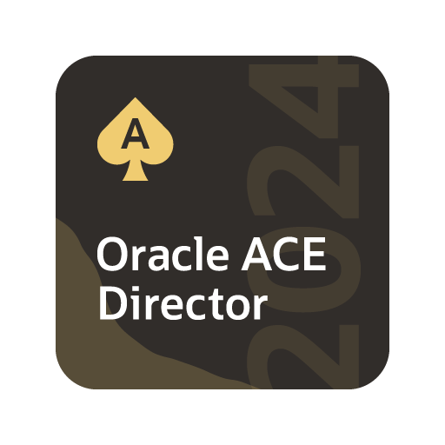
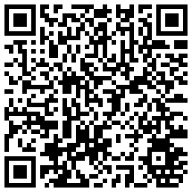
Stefan Oehrli – Modern Data Platforms
Modern
Data
Platforms
stefan.oehrli@accenture.com
Tech Architecture Manager
Since 1997 active in various IT areas
More than 25 years of experience in Oracle databases
Focus: Protecting data and operating databases securely
Security assessments and reviews
Database security concepts and their implementation
Oracle Backup & Recovery concepts and troubleshooting
Oracle Enterprise User and Advanced Security, DB Vault, …
Oracle Directory Services
Co-author of the book The Oracle DBA (Hanser, 2016/07)
oradba.ch
@stefanoehrli

Slide 4








The Oracle ACE Program
400+ technical experts helping peers globally
The Oracle ACE Program recognizes and rewards community members for their technical and community contributions to the Oracle community
3 membership levels: Director, Pro, and Associate
Nominate yourself or a colleague at ace.oracle.com/nominate
Learn more at ace.oracle.com
aceprogram_ww@oracle.com
Facebook.com/OracleACEs
@oracleace
Oracle ACE Program Group

Slide 5
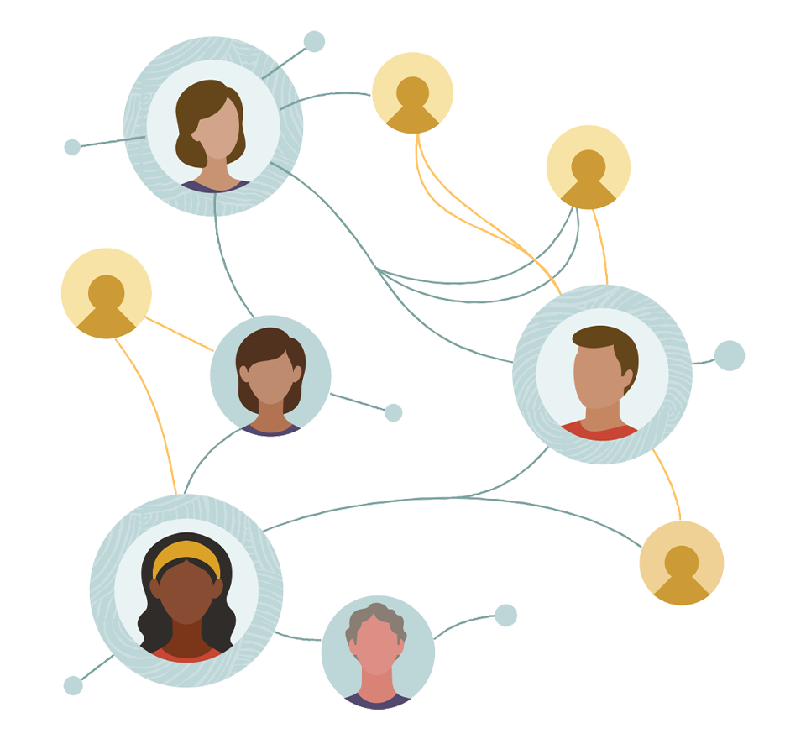






ACE Member Benefits
Key Benefits
Cool swag*, Digital awards for social media, Oracle CloudWorld pass*, & more
Direct Access to Product Management
Multiple direct communication channels to product management and fellow ACEs
Exclusive Content
Exclusive monthly virtual meetings with product development teams + engaging guest speakers
Networking
In-person & virtual networking opportunities for ACEs to connect with product development and each other.
Cloud Account
$5k USD Cloud account*
Travel Support
ACE Directors are eligible for travel support to give presentations or lead workshops at conferences globally
5
* for Pro and Director levels

Slide 6


3 key benefits
Modern Data Platforms VISON & MISSION
WHY? We are the game changer for our client's data platform projects
HOW? Maximum automation, maximum efficiency, maximum quality!
WHAT? We build innovative data platforms based on our blueprints and licensable assets and tools.
1 Architecture expertise from hands-on projects
2 Delivery of tailor-made data platforms
3 Integrated Teams Like a rowing team, perfect alignment and interaction.
Tools and Blueprints
Continuous Optimization
Expertise & Light Towers
Key enabler for the implementation of modern data platforms at a high speed and quality.
Tools and Blueprints are continuously optimized to the customer and project’s needs.
Expert group for modern data platforms from technical implementation to project management and organization

Slide 7
OCI Security
1
Introduction
2
Basic OCI Security
Hands-On Practice Workshop
3
Cloud Guard
4
Data Safe
5
Security Zones / WAF
6
Summary

Slide 8
Course Schedule
Session Times and Breaks
from | to | Topic
09:00 | 09:15 | Welcome | Course Overview and Lab Setup Instructions
09:15 | 10:30 | Basic OCI Security | In-Transit Encryption, Shielded Instances, Key Management
10:30 | 10:45 | Coffee Break
10:45 | 12:00 | Cloud Guard | Overview, Recipes, CIS Scans, Remediation, Alerts, and Events
12:00 | 13:00 | Lunch
13:00 | 14:15 | Data Safe | Overview, Setup, Auditing, Data Masking, Assessments,…
14:15 | 14:45 | Coffee Break
14:45 | 16:00 | Security Zones / WAF | Overview, Zone Management, Rulesets, and CIS Compliance
16:00 | 16:30 | Wrap-Up | Additional Resources, Next Steps, and Farewell

Slide 9
Security Service Products
Detection and Remediation
Cloud Guard
Maximum
Security Zone
Security
Advisor
Vulnerability
Scanning
Data Protection
Vault Key
Management
Vault Secrets
Management
Data Safe
Certificates
OS and Workload Protection
Shielded
Instances
Dedicated
Host
Bastion
OS
Management
IAM
IAM
MFA
Federation
Audit
Infrastructure Protection
DDoS
Web Application
Firewall
Security
Lists / NSG
Network
Firewall Appliance
Protection

Slide 10
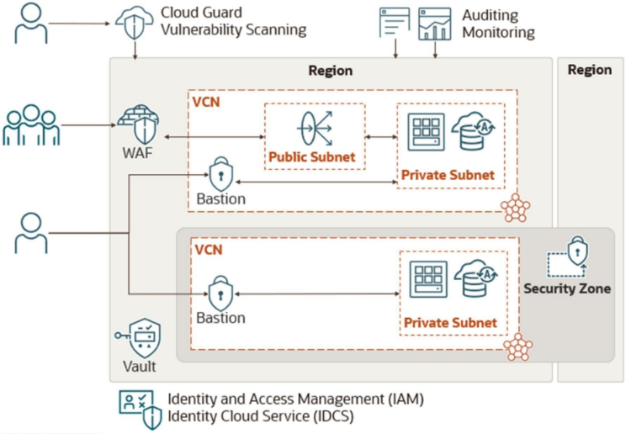
Working Together
Source: oracle.com

Slide 11
OCI Lab Architecture Overview
A High-Level View of the Infrastructure

Slide 12
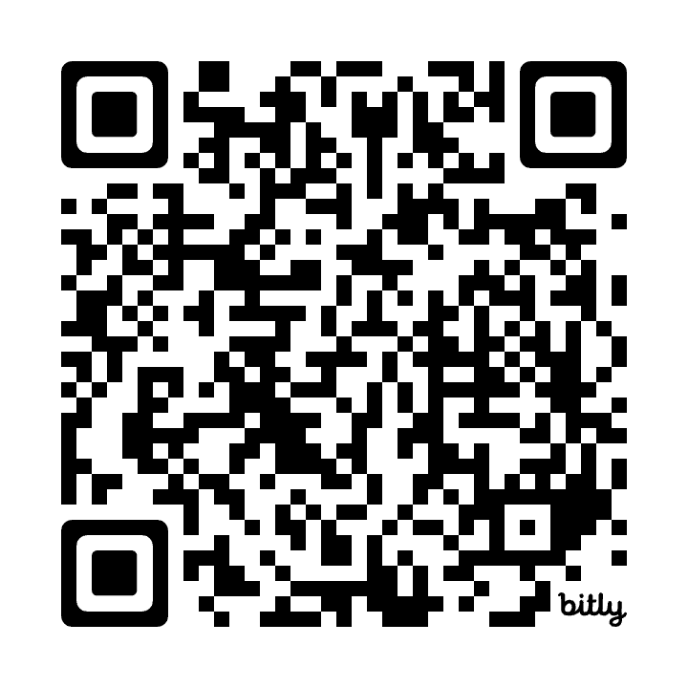
OCI Access Information
Resources and Cloud Environment Details
The course materials and exercises are available via the GitHub repository/website:
OCI Walkthrough: https://code.oradba.ch/oci-sec-ws
PDFs and Course Materials: https://code.oradba.ch/oci-sec-ws/others
For the workshop, each participant will have access to Oracle Cloud. Accenture is providing an environment with resources for the training day.
URL: http://cloud.oracle.com
Tenant: Provided by the instructor
User: DOAGOCINN
Password: Provided by the instructor
Compartment: StudentNN

Slide 13
Thank You

